Slide 1
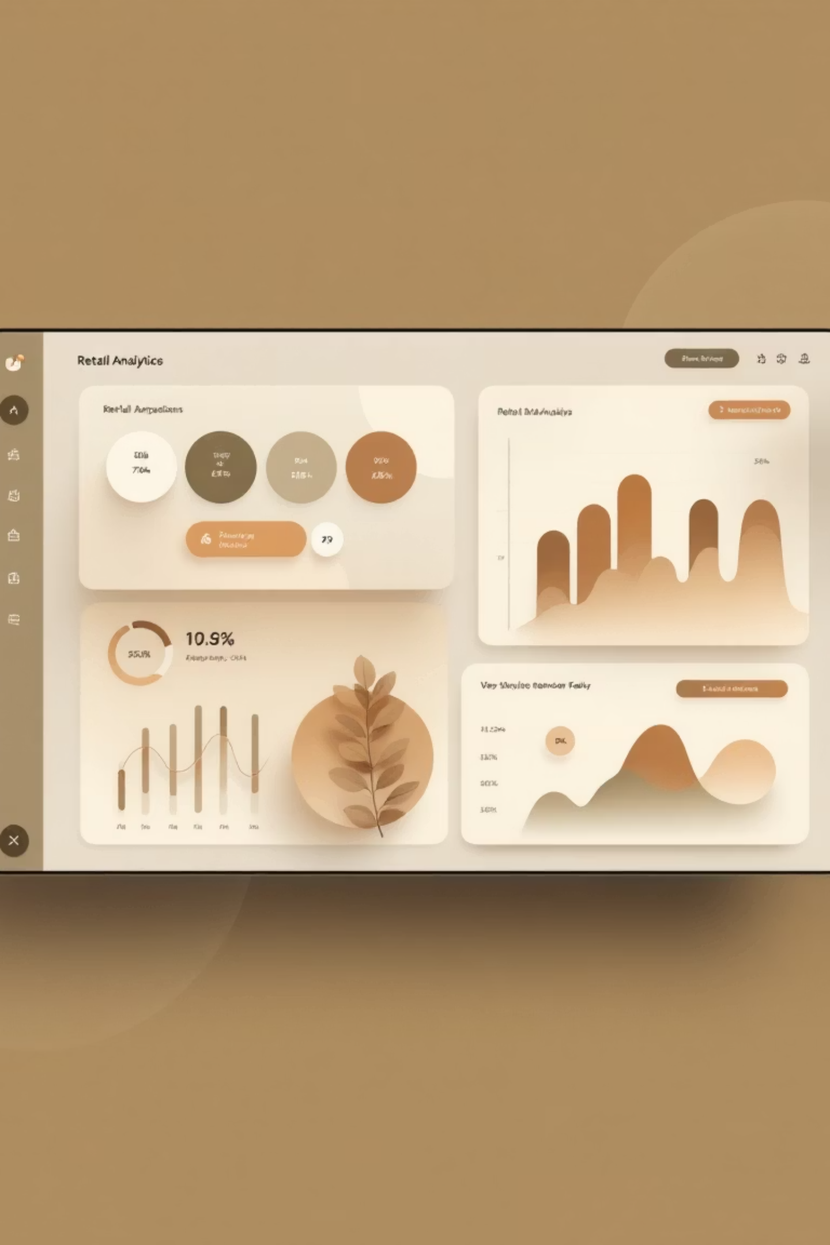
Customer Shopping Behavior Analysis
Uncovering insights from 3,900 purchases to drive strategic decisions for improved customer engagement and revenue growth.
Priyanshu_7027

Slide 2

The Challenge
Business Context
Core Question
A leading retail company noticed changes in purchasing patterns across demographics, product categories, and sales channels.
"How can the company leverage consumer shopping data to identify trends, improve customer engagement, and optimize marketing and product strategies?"
Priyanshu_7027

Slide 3
Dataset Overview
3,900
18
37
Total Purchases
Data Points
Missing Values
Comprehensive transaction records analyzed
Rich features across demographics and behavior
Handled via median imputation
Customer Demographics
Purchase Details
Behavioral Indicators
Age, Gender, Location, Subscription Status
Item, Category, Amount, Season, Size, Color
Discounts, Previous Purchases, Frequency, Reviews, Shipping
Priyanshu_7027

Slide 4




Our Analytical Approach
Python EDA
Data cleaning, feature engineering, and preparation
SQL Analysis
PostgreSQL queries for business insights
Power BI
Interactive visualization and reporting
Priyanshu_7027

Slide 5
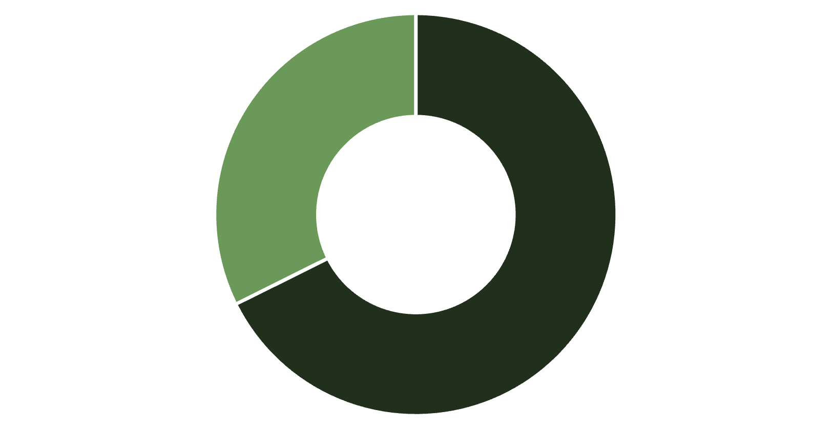

Revenue by Gender
Key Finding
Male customers contribute 2x more revenue than female customers (₹157,890 vs ₹75,191).
Significant opportunity to improve engagement and conversion among female customers through targeted marketing strategies.
Male
Female
Priyanshu_7027

Slide 6



Customer Segmentation Insights
80%
18%
2%
Loyal Customers
Returning
New
3,116 customers with 10+ purchases
701 customers with 2-10 purchases
83 customers with 1 purchase
Strong loyal customer base indicates excellent satisfaction and long-term engagement. Focus on converting returning customers to loyal status.
Priyanshu_7027

Slide 7
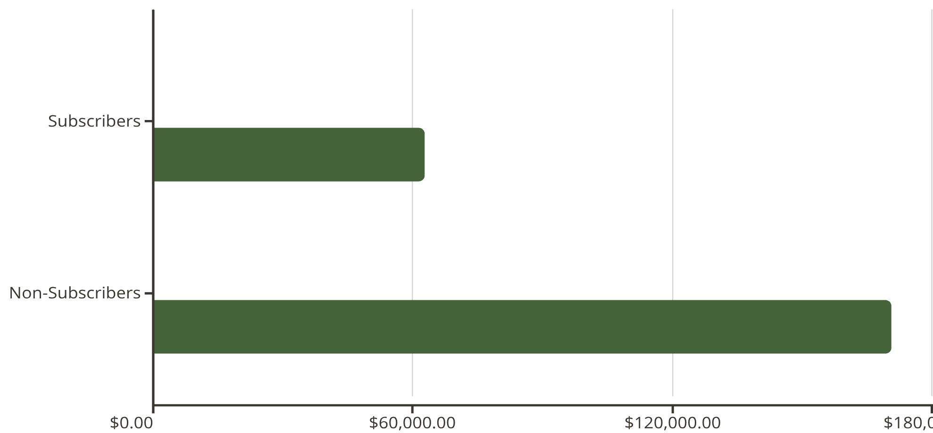
Subscription Impact
Repeat Buyers & Subscriptions
Among customers with 5+ purchases:
958 are subscribers
2,518 are not subscribed
Opportunity: Target high-frequency buyers with subscription campaigns.
Avg Spend
Total Revenue
Priyanshu_7027

Slide 8
Product Performance
1
2
3
Top Rated: Gloves
Sandals
Boots
Average rating: 3.86 stars
Average rating: 3.84 stars
Average rating: 3.82 stars
4
5
Hat
Skirt
Average rating: 3.80 stars
Average rating: 3.78 stars
Discount-Dependent Products
Hat (50%), Sneakers (49%), and Coat (49%) show highest discount rates, indicating price sensitivity.
Priyanshu_7027

Slide 9
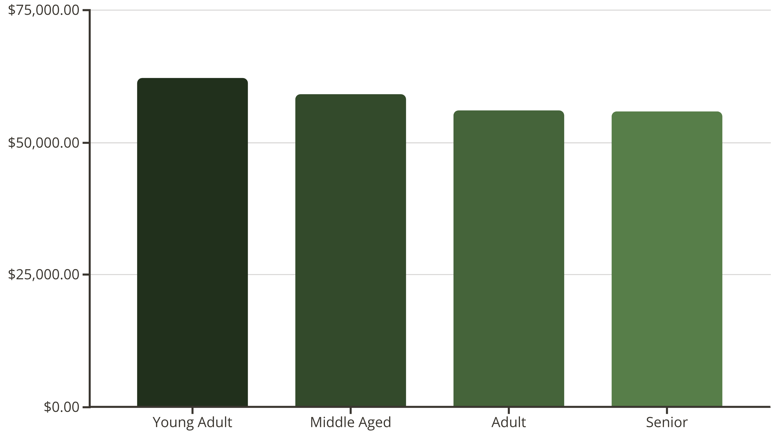
Revenue by Age Group
Priyanshu_7027
Young adults lead revenue contribution, followed closely by middle-aged customers. Balanced distribution suggests broad market appeal.

Slide 10





Strategic Recommendations
Boost Subscriptions
Strengthen Loyalty
Optimize Discounts
Target 2,518 repeat buyers who aren't subscribed with exclusive benefits campaigns
Reward returning customers to convert them into the loyal segment
Strategic discounting for price-sensitive products without eroding margins
Targeted Marketing
Female Engagement
Focus on young adults and express-shipping customers for high-value outreach
Develop campaigns to close the 2x revenue gap with male customers
Priyanshu_7027

